Slide 1
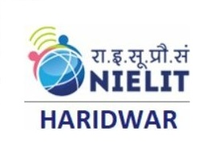
Overview on Futuristic IT Technology & ^{Cyber Security}
^{TOPIC:}
COURSE: CCC Concepts
CHAPTER: 09 (Overview on Futuristic IT Technology & Cyber Security)
DAY: 44
NIELIT
Presented By: Shruti Dubey

Slide 2
CONTENTS
Introduction to Futureskills
Internet of Things (IoT)
Big Data Analytics
Cloud Computing
Virtual Reality
Artificial Intelligence
Social & Mobile
Blockchain Technology
3D Printing/ Additive Manufacturing
Robotics Process Automation
Cyber World
Need of Cyber Security
Securing PC
Securing Smart Phone
Summary

Slide 3
Introduction to Futureskills
FutureSkills is an initiative aimed at enabling India to be accelerated on a journey to build its skills and become a global hub for talent in emerging (latest) technologies in-line with the Digital India initiative of Govt. of India.
The FutureSkills platform was launched by the Hon’ble Prime Minister of India on 19thFebruary 2018 at World Congress of Information Technology, Hyderabad in the presence of senior industry leaders and government officials to Upskill Technology Professionals in India.

Slide 4
Introduction to Futureskills
FutureSkills is a new age learning experience platform from NASSCOM (National Association of Software and Services Companies) for building skills in ten futuristic technology areas.
These technologies are Robotics Process Automation(RPA), Artificial Intelligence (AI), Internet of Things (IoT), Cyber Security, Blockchain, Virtual Reality (VR), Social & Mobile, Big Data Analytics, Cloud Computing and 3D Printing.

Slide 5
Why Futureskills?
The IT-ITeS industry requires a massive manpower in the area of emerging technologies which are changing the future of work.
It is estimated that out of about 45 lakhs people employed in the IT industry as on date and about 15-20 lakhs peoples are expected to require Reskilling (upskilling) in the next 4-5 years.
The problem is too large to be handled alone and needs a collaborative industry level response. This industry driven learning eco-system is FutureSkills.

Slide 6
Future skills
Internet of Things (IoT)
Virtual Reality
Big Data Analytics
3D Printing
Cloud Computing
Cyber Security
Social and Mobile
Artificial Intelligence
Blockchain Technology
Robotics Process Automation

Slide 7
Internet of Things (IoT)
The Internet of things (IoT) is the network of devices such as vehicles, home& office appliances and other devices, that contain electronics, software, actuators, and connectivity which allows these things to connect, interact and exchange data.
It involves extending Internet connectivity beyond standard devices, such as desktops, laptops, smart phones and tablets, to any range of traditionally dumb or non-internet-enabled physical devices and everyday objects.
Embedded with technology, these devices can communicate and interact over the Internet, and they can be remotely monitored and controlled.
Communicating objects based on internet technologies
Detection and identification and location of physical objects
Communication through connectivity
Every physical object must be equipped with an IPv6-address.

Slide 8
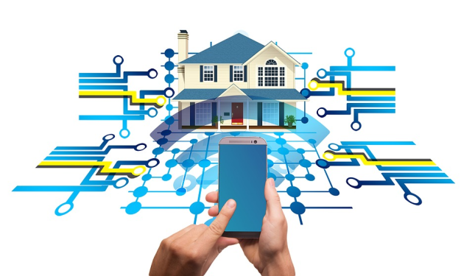
Some real world Example of IoT Application
Smart Home
In smart home all necessary things like switches, lights, AC (or in other words all electronic equipments) are controlled by Mobile application or Personnel computer.
This technology provides homeowners security, comfort, convenience and energy efficiency by allowing them to control smart devices, often by a smart home app on their smart phone or other networked device.

Slide 9
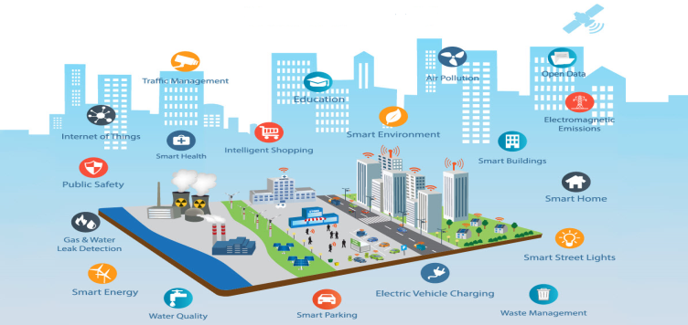
Some real world Example of IoT Application
Smart Cities
The Internet of Things (IoT) offers new opportunities for cities to use data to manage traffic, cut pollution, make better use of infrastructure and keep citizens safe.
The objective of Smart city would be to use technology to offer services that are intelligent, advanced, affordable and accessible.

Slide 10
Some real world Example of IoT Application
IoT in agriculture
In agriculture using of the IoT technology in order to make smarter decisions, reduce costs, and boost productions of crops.
Applications of IoT in Agricultural systems are very useful for the formers. It helps in checking of soil moisture, nutrient and PH levels in the field.
It also helps in weather forecasting, water requirement for crops etc.
A system is built for monitoring the crop field with the help of sensors (light, humidity, temperature, soil moisture, etc.)
The real-time data about the soil and crop status is being monitored by the farmer like the farmer gets a notification about watering the crops etc.

Slide 11
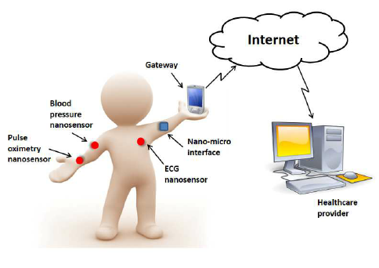
Some real world Example of IoT Application
IoT in Healthcare
The internet of things has numerous applications in healthcare, from remote monitoring to smart sensors and medical device integration.
The body functions monitoring sensors are connected to the network to update the doctor or the hospital about the patient’s real-time status like heart beat status or liver functioning etc.
Also in the critical situations an ambulance can be called automatically.

Slide 12
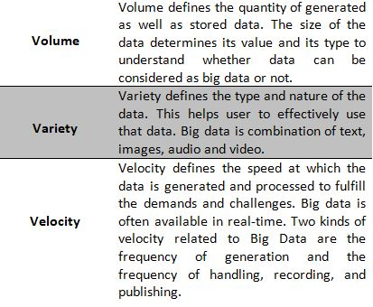
Big Data Analytics
Big data is a term, used to refer data sets that are too large or complex.
For processing of this type of data sets use special type of application software. Big data was originally associated with three key concepts: Volume, Variety and Velocity.

Slide 13
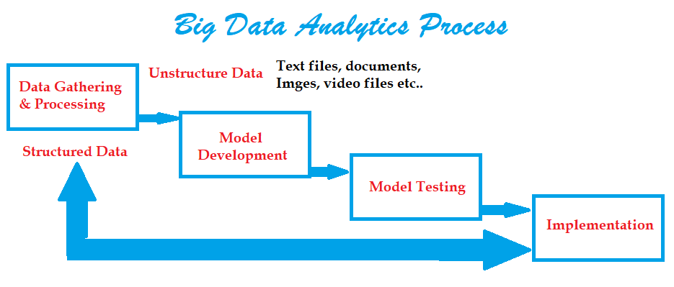
Big Data Analytics Process for an Industry
Structure Vs Unstructured Data
Data Gathering and processing
Model development
Model Testing on Random Sample
Implementation on Data

Slide 14
Thank you! If you have any query, please contact:
NIELIT
www.nielit.gov.in/haridwar

